Slide 1
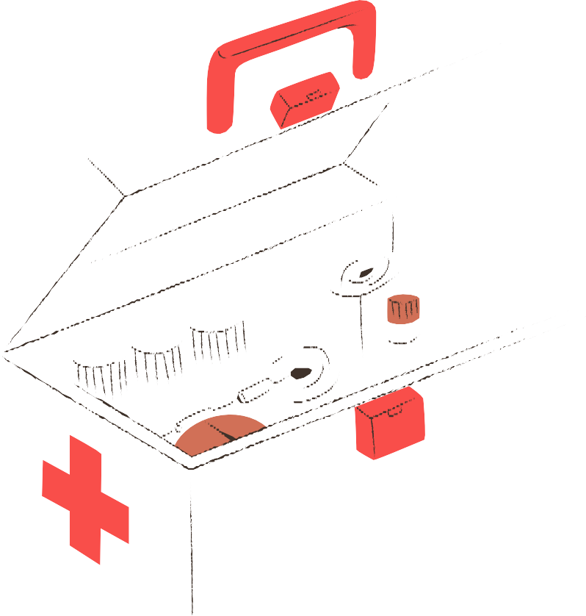
急救⼩天使

Slide 2
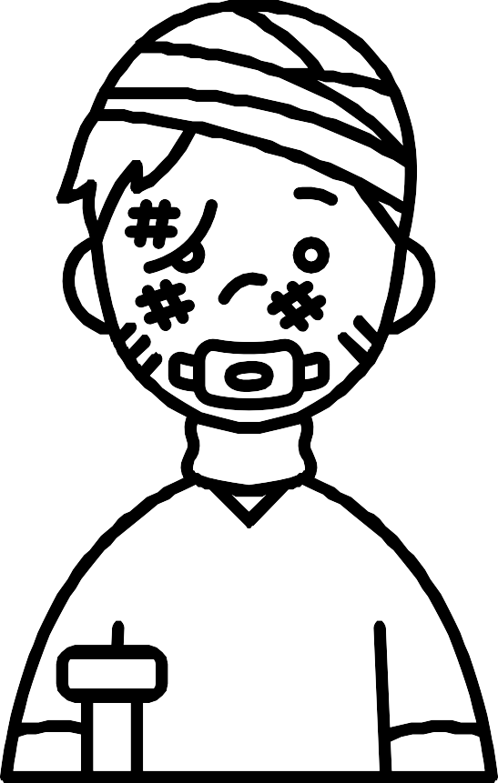
Car crash ⾞禍 scratch 抓傷、擦傷 sprain 拉傷
What kind of injury experience do you have?
twist 扭傷 fracture ⾻折 cramp 抽筋

Slide 3
急救步驟
保持冷靜
評估環境: 確保⾃⾝安全
評估傷者狀況:傷勢嚴重性、急救優先順序
尋求⽀援:撥打緊急救難電話並告知事故發⽣相關資 訊

Slide 4
⼀般受傷
沖、擦、敷、看
紗布、絆創膠帶、剪⼑、彈性繃 帶、棉棒、酒精棉花、優碘、鑷
⼦、OK蹦

Slide 5
⼀般受傷
First aid急救
red and swollen 紅腫 bandage 包紮
triangular bandage 三⾓⼱

Slide 6
How to Stop the blood

Slide 7
direct pressure
cover the wound with a clean dressing or bandage

Slide 8
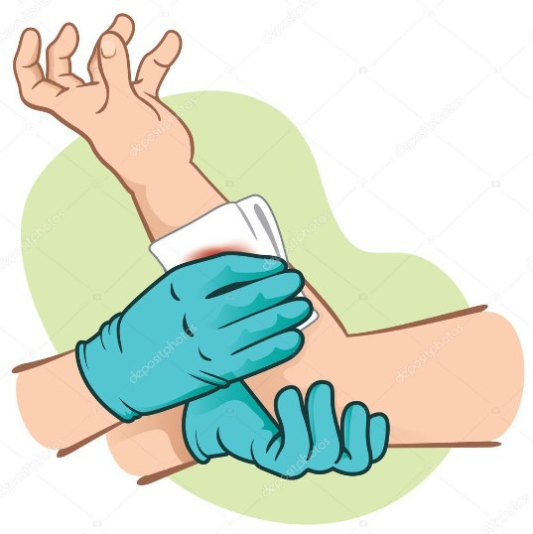
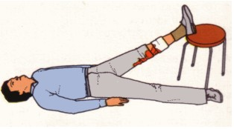
elevating the injured limb to stop bleeding

Slide 9
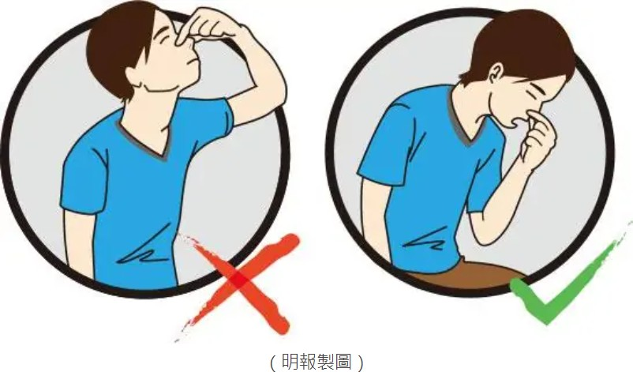
Nosebleed
pinch the nose and lean forward, holding it for 5 to 10 minutes.
sometimes an ice pack can also be helpful

Slide 10
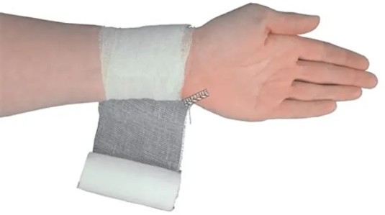
roller bandage
Bandaging method
⽤於等粗體
不宜過緊

Slide 11
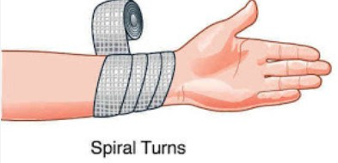
reverse spiral bandage
Bandaging method
遠⼼端⾄近⼼端
適⽤於粗細不均的肢體
每⼀圈與上⼀圈重疊2/1到3/1

Slide 12
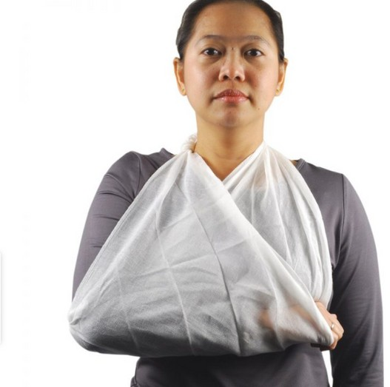
triangle bandage
Bandaging method
須露出⼿指
將肘關節部分多於布料打結

